Slide 1


21st Primary School of Athens “Lela Karagianni”
Erasmus + KA1
Helsinki/Vantaa Finland
May 2018

Slide 2
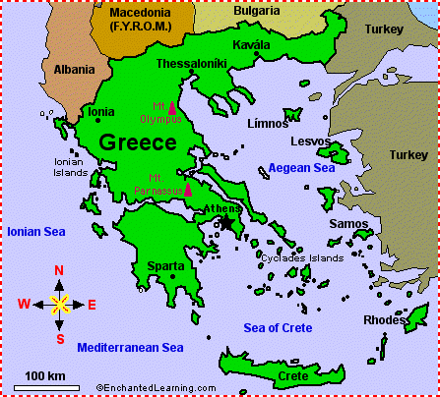
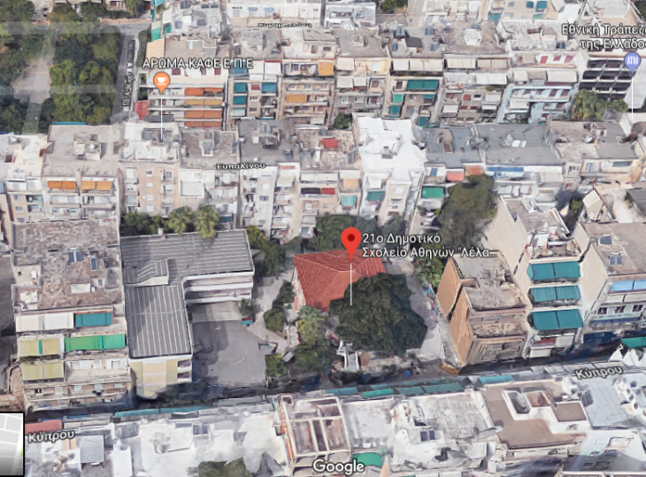
21st school of Athens
Located near the center of Athens – the capital of Greece.
Over-populated area where most of the residents are economic migrants and refugees.

Slide 3
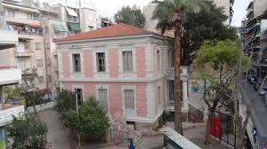
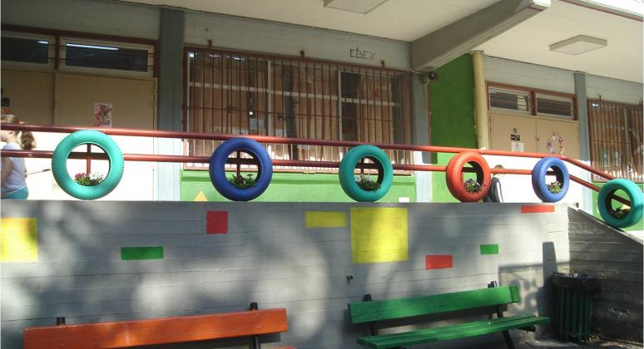
Two buildings, one new and one older (neoclassical building)
Big public Primary School, dating back to 1934.

Slide 4
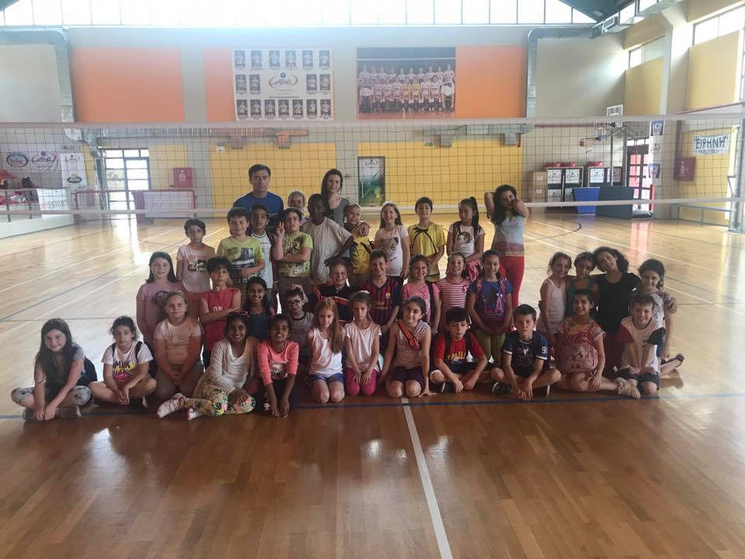
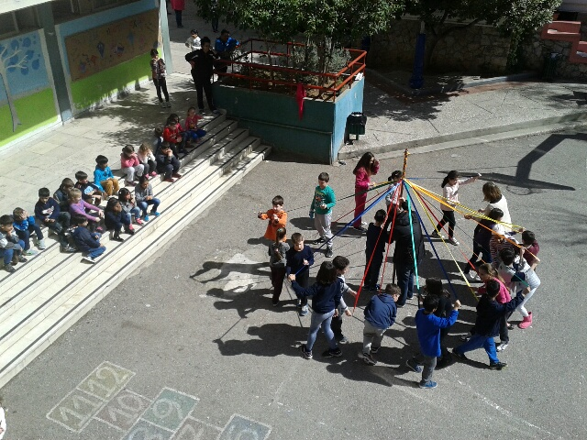
6 grades of primary education
(ages 6-12).
234 students .
Students’ registration isn’t a parental choice. It depends on residence.

Slide 5
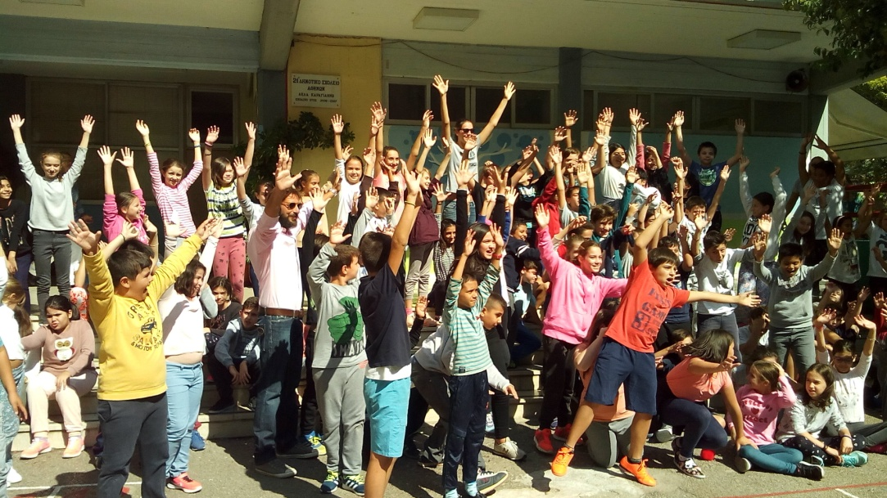
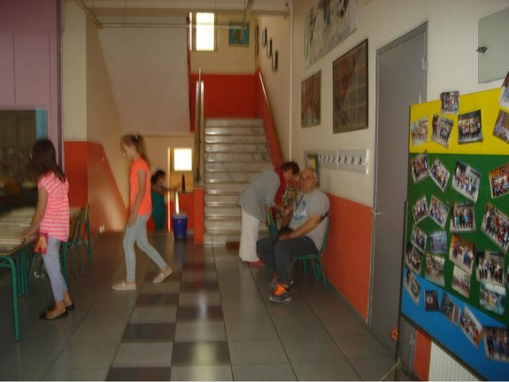
234 students from 21 countries
60 from Albania
22 from Romania
9 from Nigeria
27 from Syria (NAMs)

Slide 6
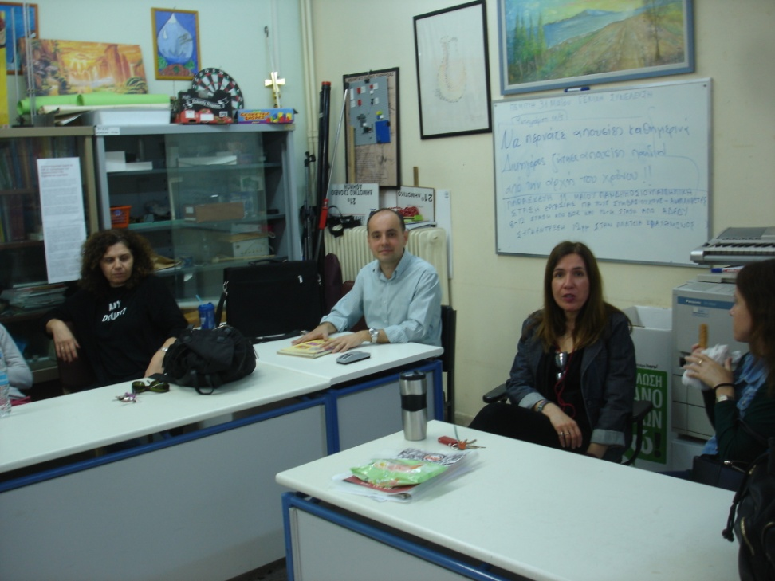
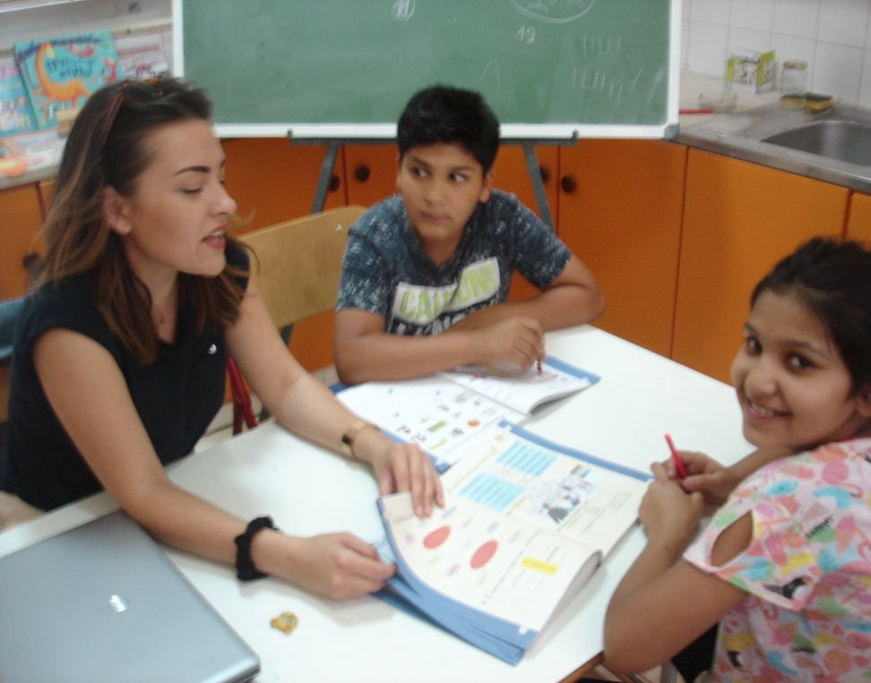
23 teachers (11 teachers for general subjects: greek language, maths, history, science, geography, religious studies)
9 teachers for special subject: (English, German, French, Music, Art, Computer Science, Physical Education)
1 teacher for the integration class (students with special education needs)
2 teachers for the reception class

Slide 7
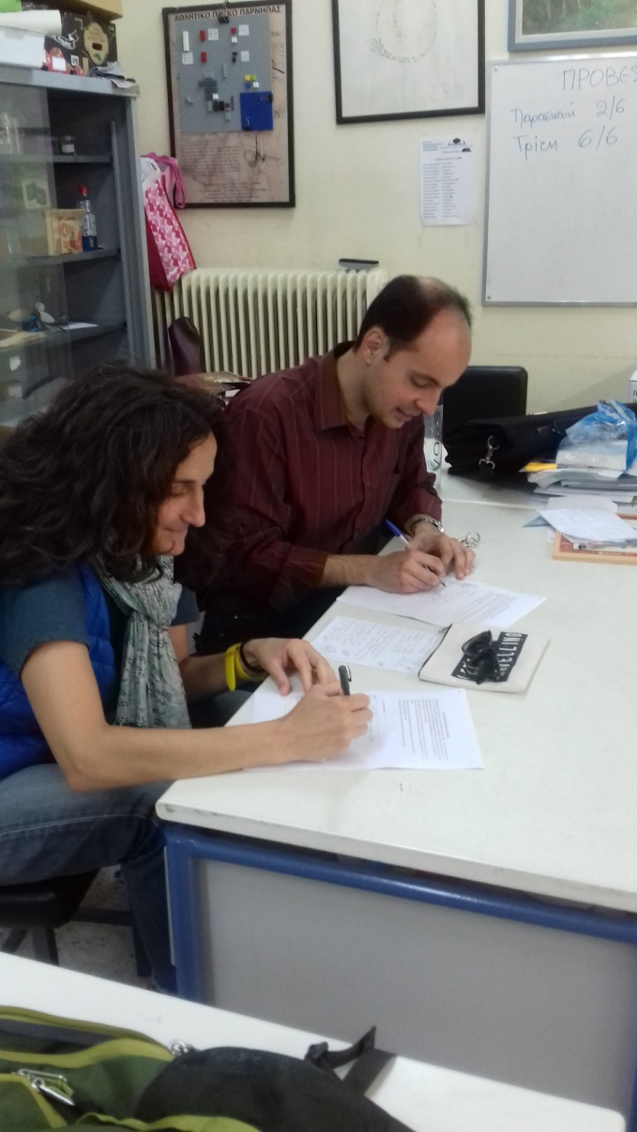
Newly appointed teachers work 24 hours/week. Reduction to 21 hours. Stay at school 30h/week.

Slide 8
Weekly schedule
subjects | 1st grade | 2nd | 3rd | 4th | 5th | 6
Language | 9 | 9 | 8 | 8 | 7 | 7
Mathematics | 5 | 5 | 4 | 4 | 4 | 4
History |  |  | 2 | 2 | 2 | 2
Science |  |  |  |  | 3 | 3
Religious education |  |  | 2 | 2 | 1 | 1
Environmental studies | 4 | 4 | 2 | 2
Physical education | 3 | 3 | 3 | 3 | 2 | 2
Art | 1 | 1 | 1 | 1 | 1 | 1
Music | 1 | 1 | 1 | 1 | 1 | 1
Theater | 1 | 1 | 1 | 1
Geography |  |  |  |  | 2 | 2
Social & Political Education |  |  |  |  | 1 | 1
ICTs | 1 | 1 | 1 | 1 | 1 | 1
English | 1 | 1 | 3 | 3 | 3 | 3
French or German |  |  |  |  | 2 | 2
Flexible zone/projects | 3 | 3 | 2 | 2

Slide 9
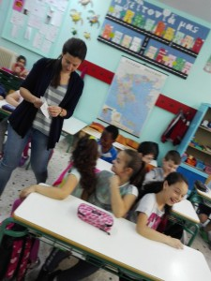
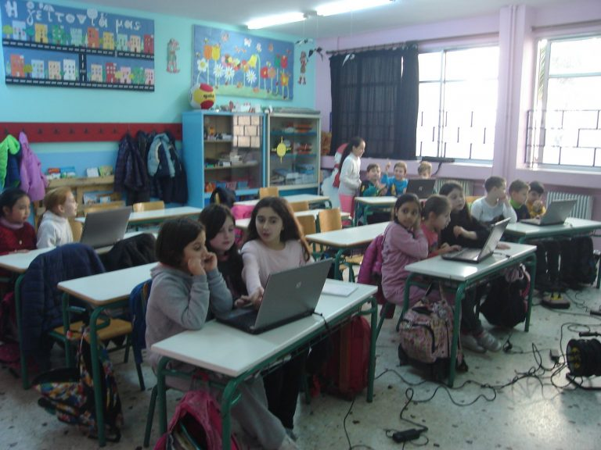
11 classrooms, 2 classes each (except 1st grade), 20 -22 students/class
1 integration class, attended by 12 students
2 reception classes, attended by newly arrived migrants

Slide 10
7.45 – 4.00 | Daily Programme
7.45 – 8.00 | Morning zone (optional)
8.00 – 8.15 | Students’ arrival (reception)
8.15 – 9.40 | 1st and 2nd period
9.40 – 10.00 | Break
10.00 – 11.30 | 3rd and 4th period
11.30 – 11.45 | Break
11.45 – 12.25 | 5th period
12.25 – 12.35 | Break
12.35 – 1.15 | 6th period (end of compulsory timetable)
1.20 – 4.00 | Extended school (all day)
1.20 – 2.00 | 1st hour (lunch/relaxation)
2.00 – 2.15 | Break
2.15 – 3.00 | 2nd hour - study / preparation for next day
3.00 – 3.15 | Break
3.15 – 4.00 | 3rd hour- optional subjects (ICTs, English, sports, music..)

Slide 11
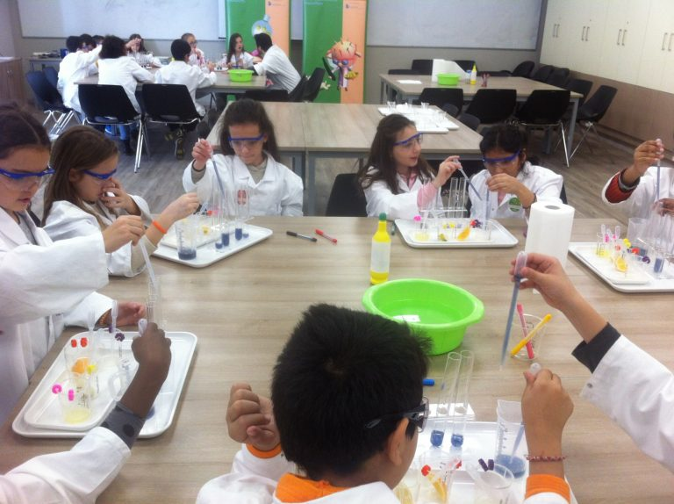
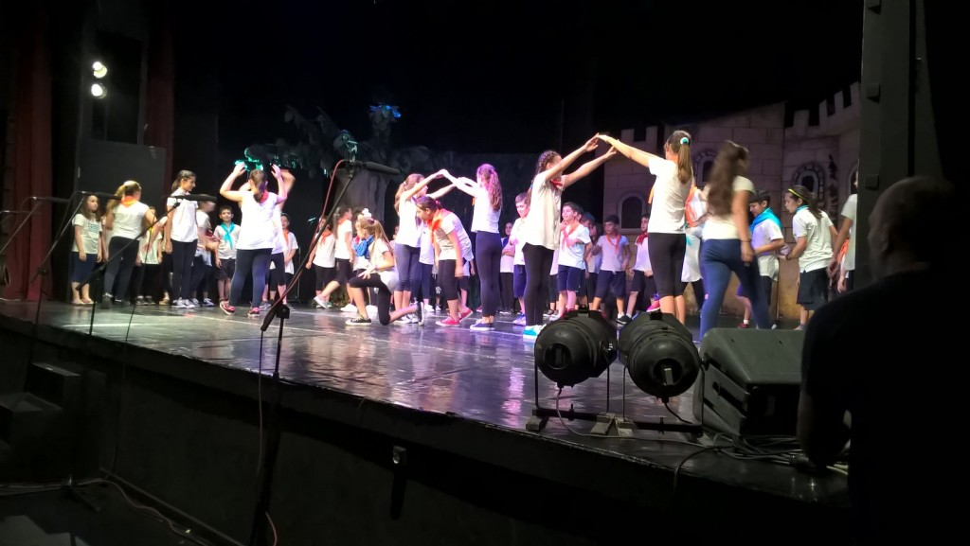
The mission of 21st Primary School
A school as spiritual workshop that “creates” happy, sensitive, informed, responsible and active citizens

Slide 12
Aims of school are:
providing equal opportunity for all
developing a variety of skills for teachers
providing a variety of extra curriculum activities
cultivating values such as: respect, empathy, tolerance, appreciation
encouraging cultural understanding, tolerance and the enjoyment of diversity
engaging parents, the community and the local agencies in support of the school
developing a caring attitude for the environment

Slide 13
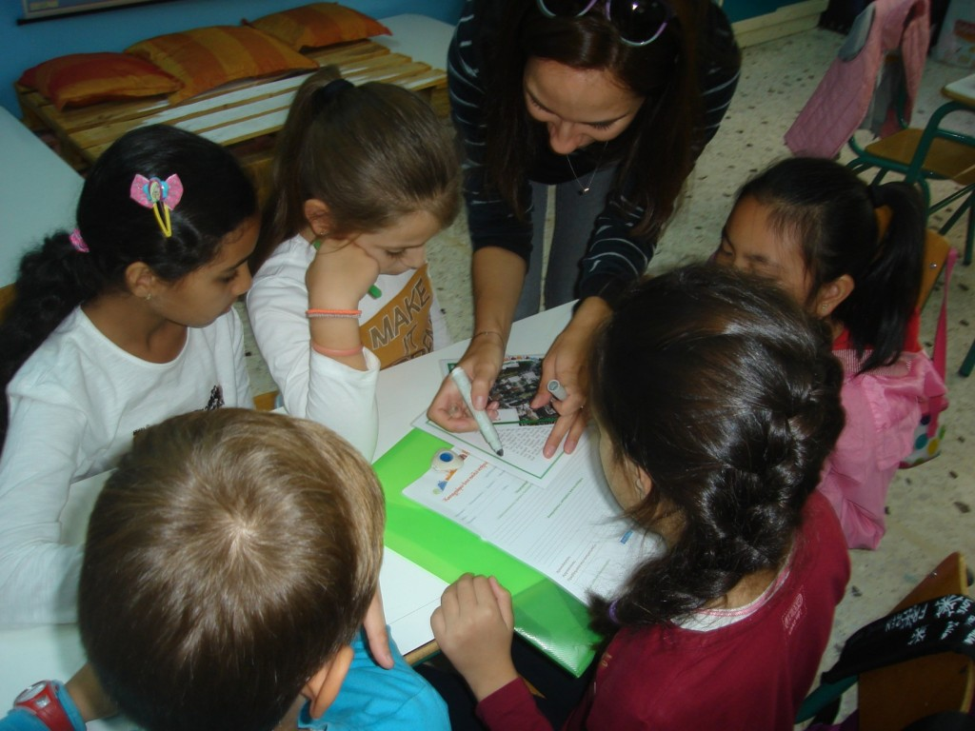
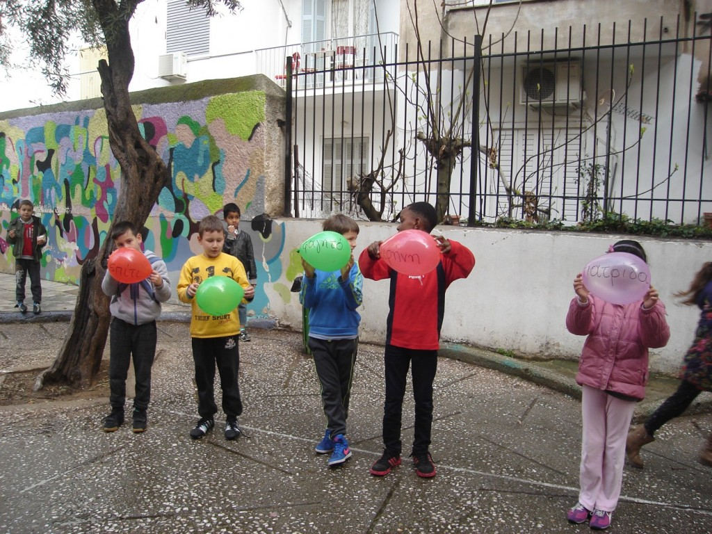
Newly arrived refugees welcome to School .

Slide 14
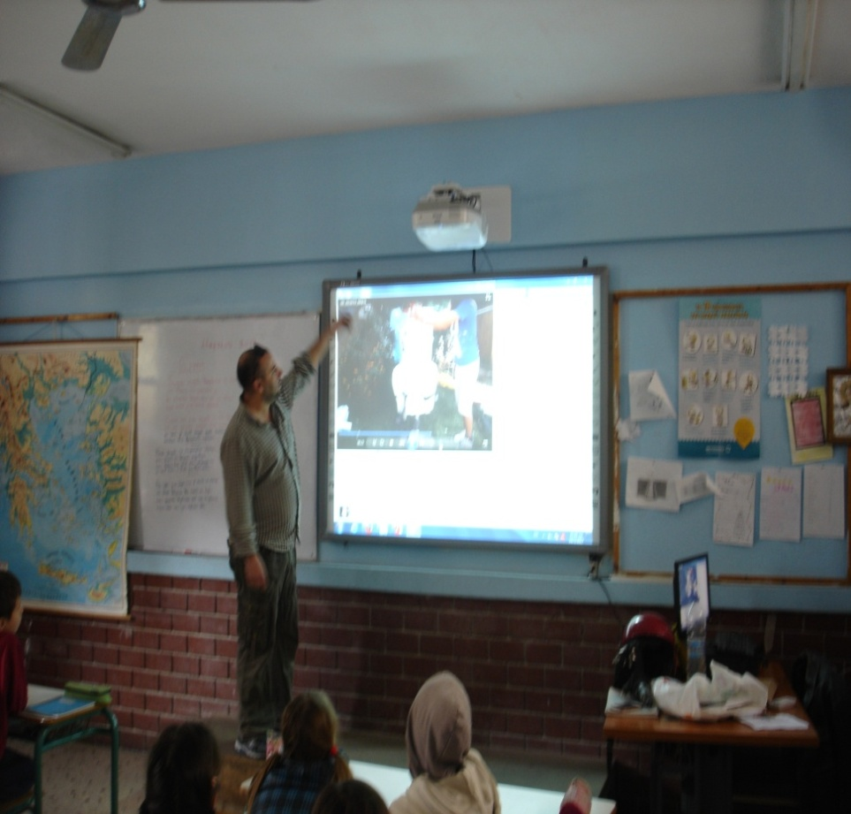
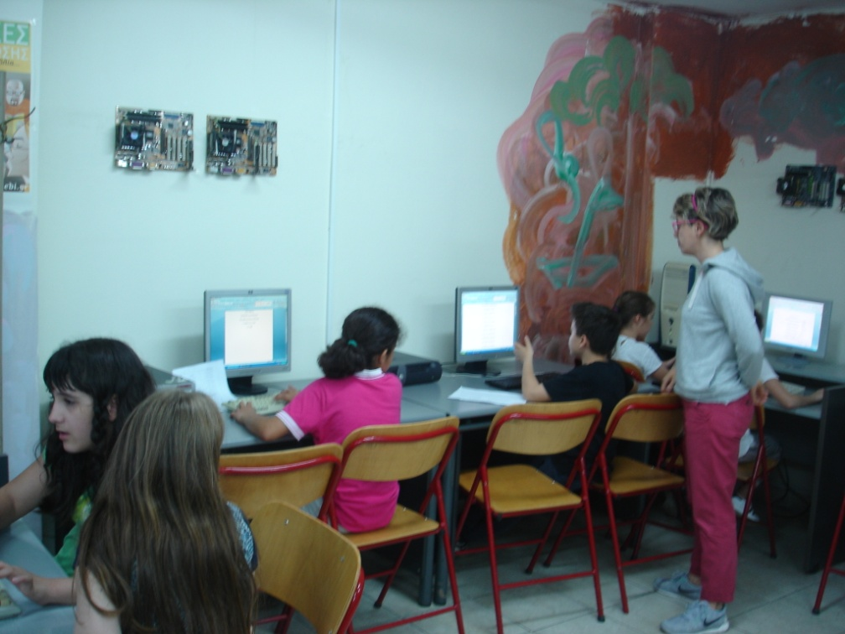
Digital tools and activities with computer are part of every teaching process. Each class has own interactive whiteboard and computer.In addition there is a computer lab for the subject «Computer Science”.

Slide 15
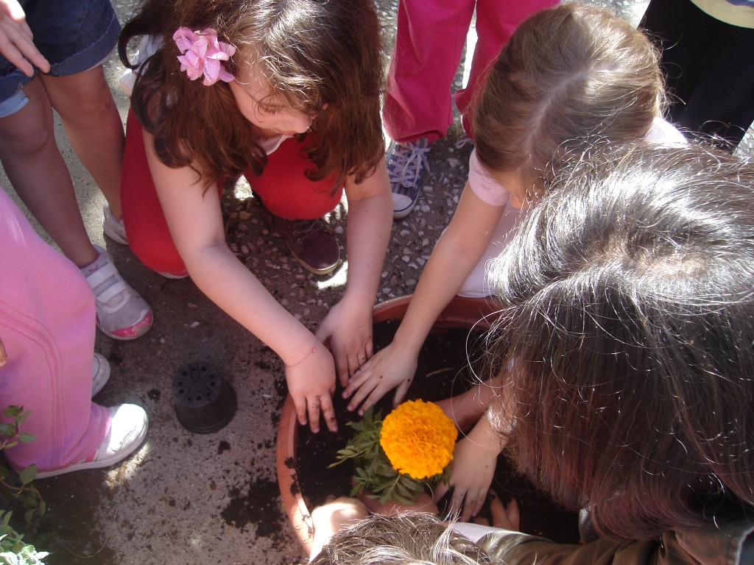
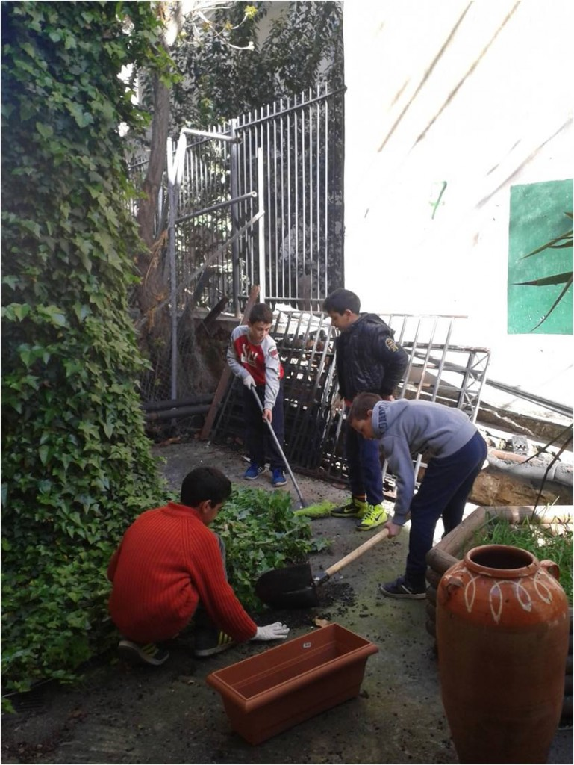
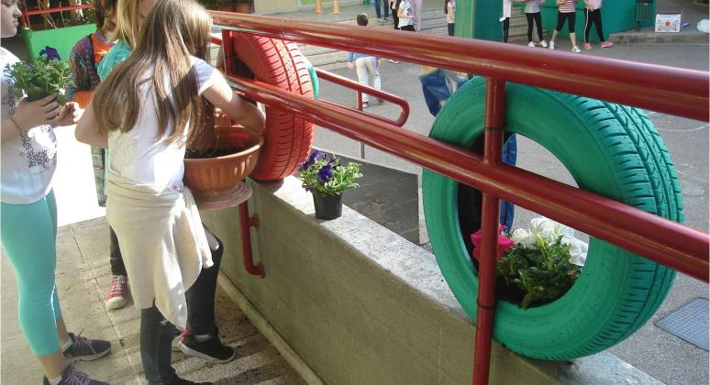
Students as gardeners cultivate flowers,vegetables and herbes in the schoolyard.

Slide 16
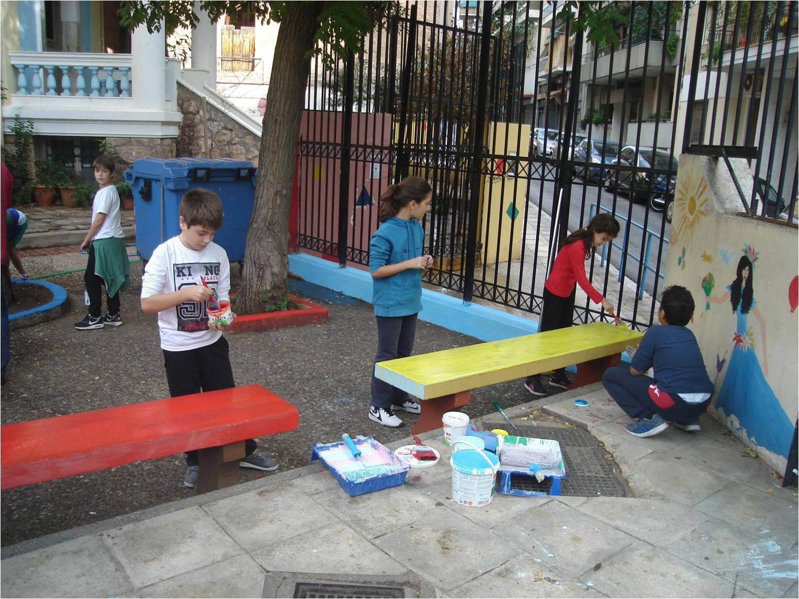
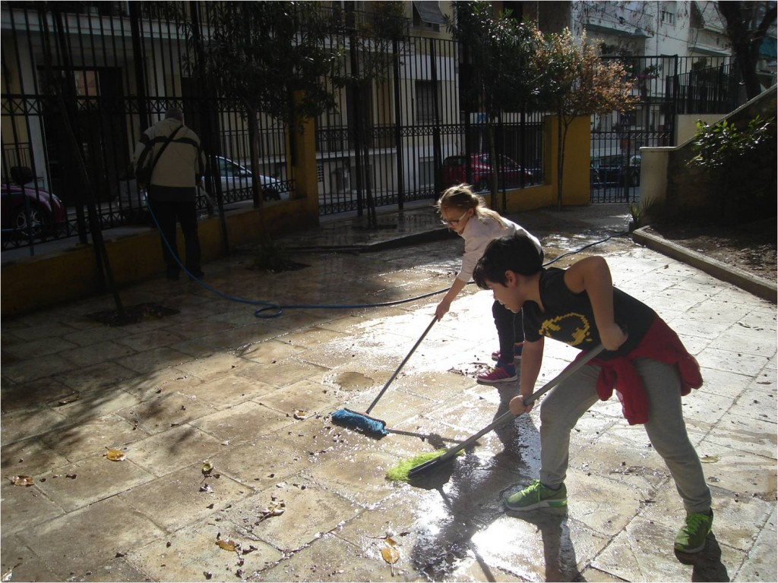
Students “adopt” the square of the neighborhood,take care of it, make it sustainable&accessible to the citizens.

Slide 17
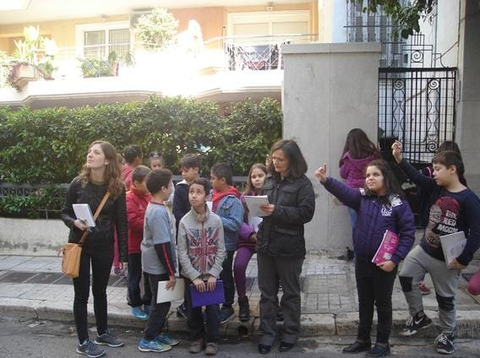
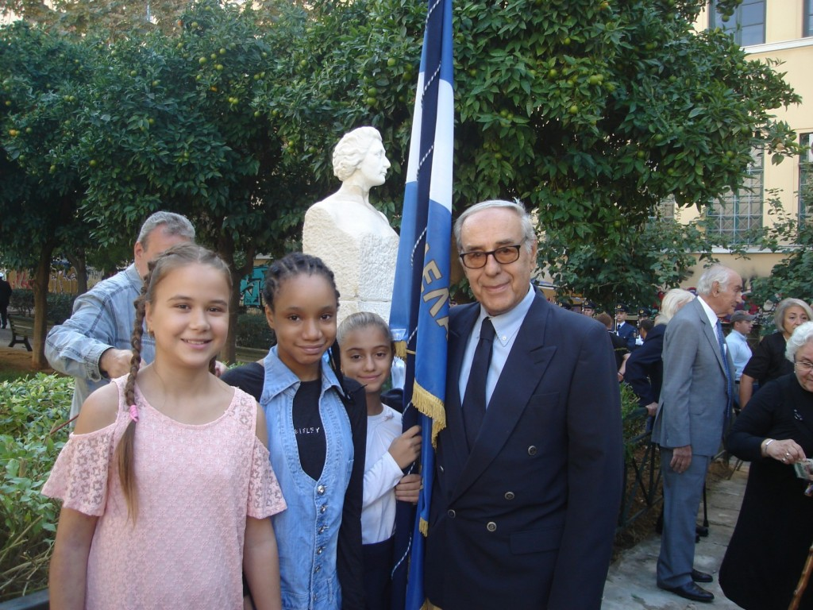
Students record old buildings of cultural heritage in the neighborhood around the school where the resisting heroine “Lela Karagianni” lived.

Slide 18
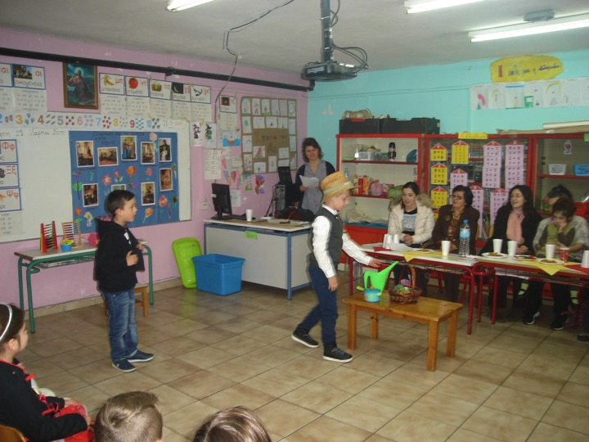
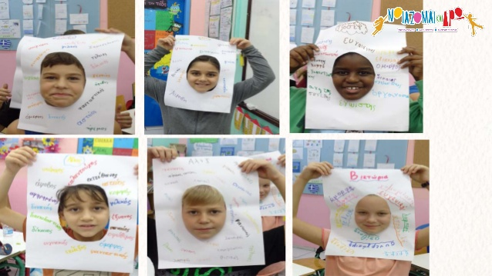
21st Primary School runs projects within curriculum about informal education like emotional, environmental, cultural, health education.

Slide 19
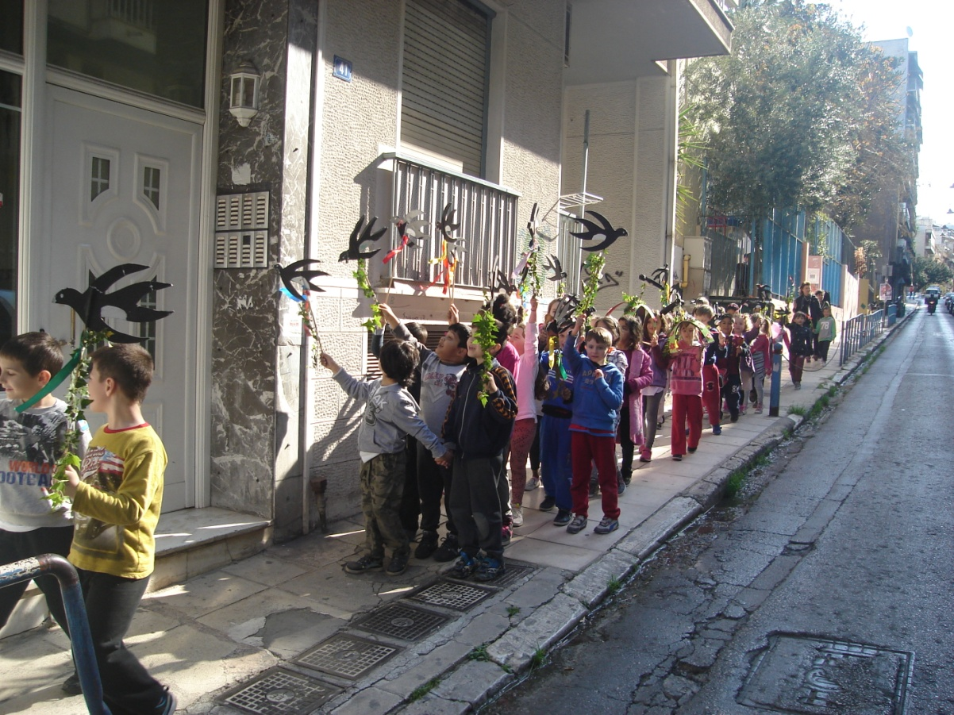
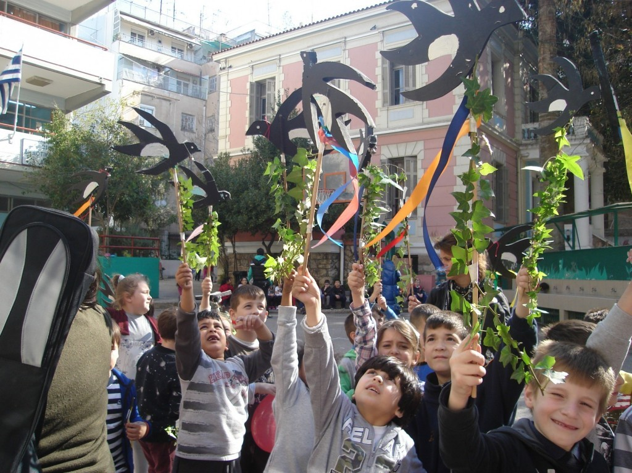
Outdoor activities
Our 1st graders celebrate the spring’s coming.They sing the “swalows”, traditional songs.in the neighborhood.

Slide 20
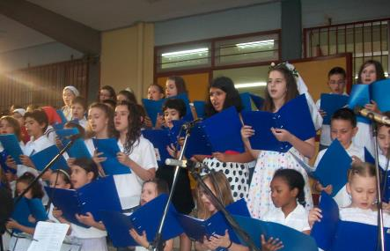
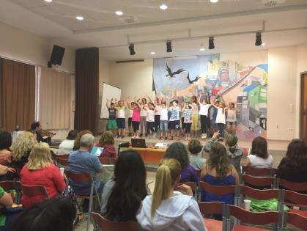
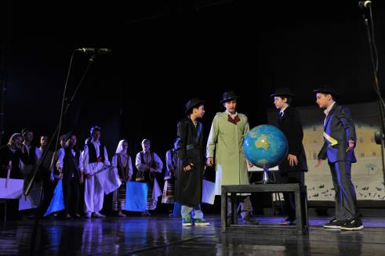
Cultural activities

Slide 21
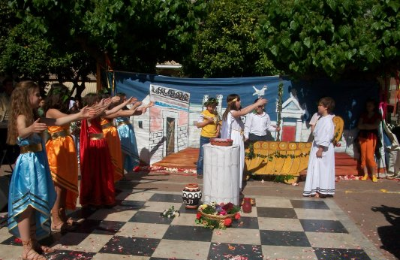
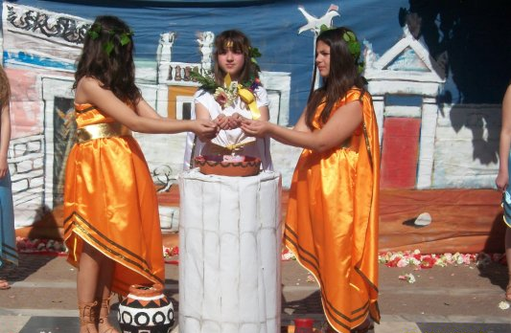
Students represent ancient local customs with drama, songs and music.

Slide 22
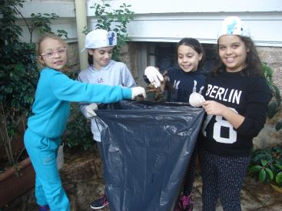
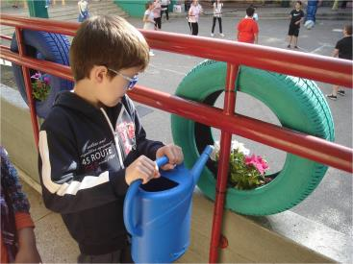

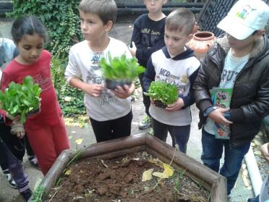
Environmental activities

Slide 23
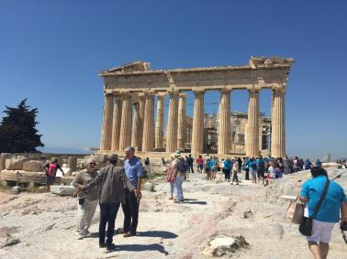
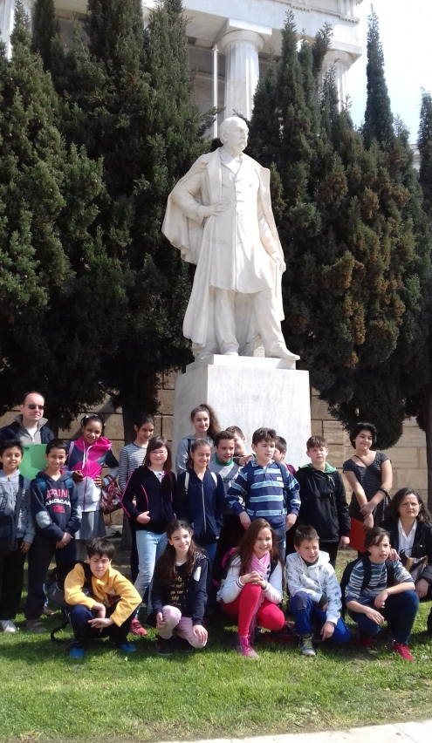
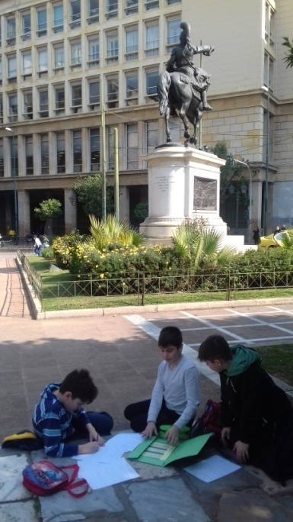
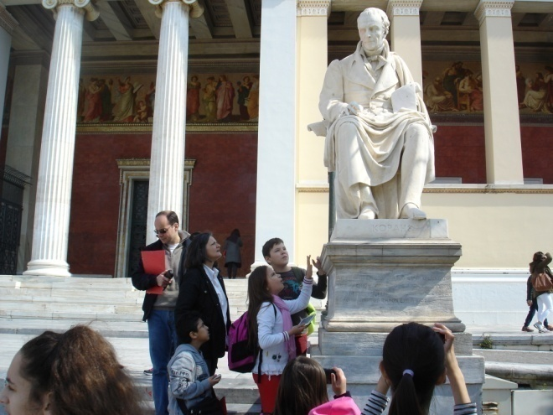
Discovering the monuments of Athens.
Project “adopt a monument”

Slide 24
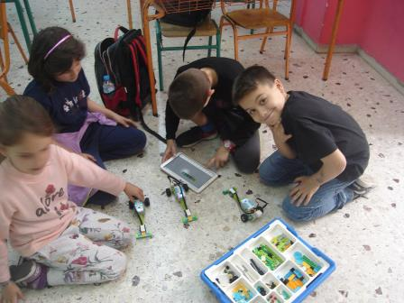
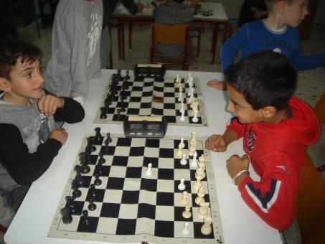
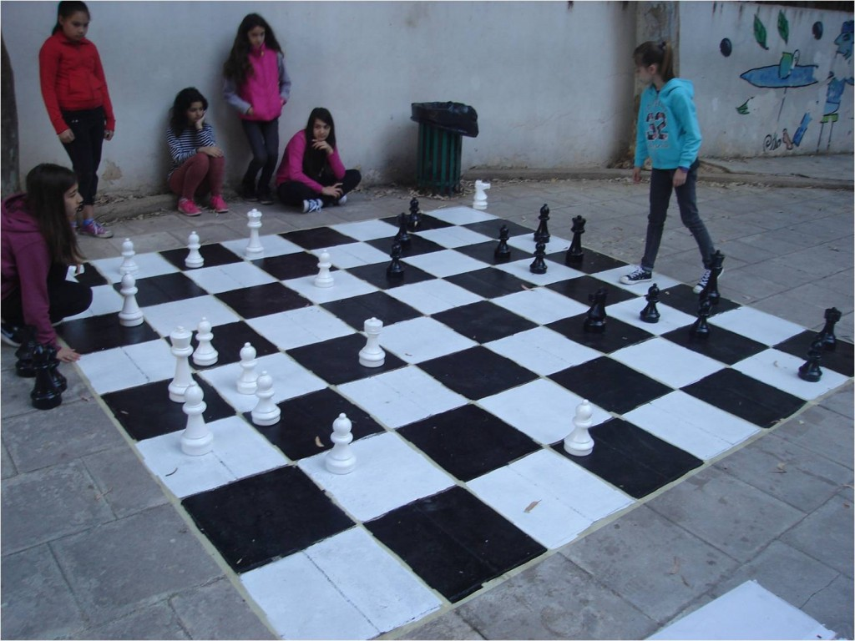
After school activities
Chess and robotics lessons .

Slide 25
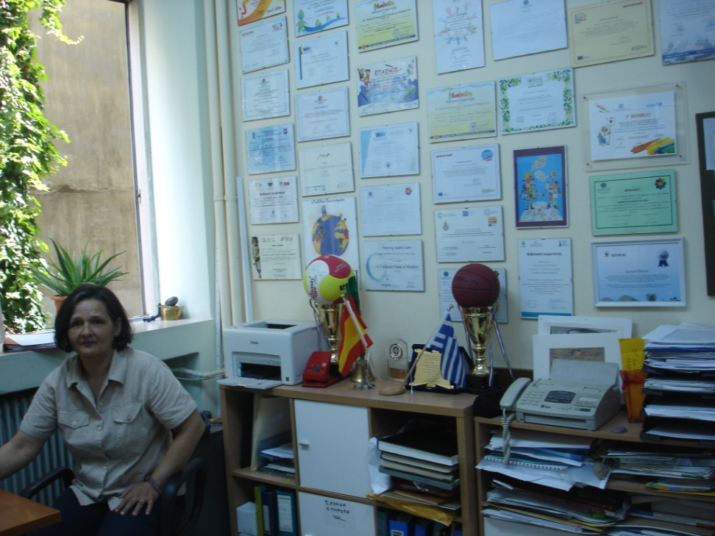
Crucial and important factor for all the objectives of School is the Distributed Leadership who facilitates,supports and fosters the collaboration, the democracy and the personal development of teachers for students’ achievement.

Slide 26

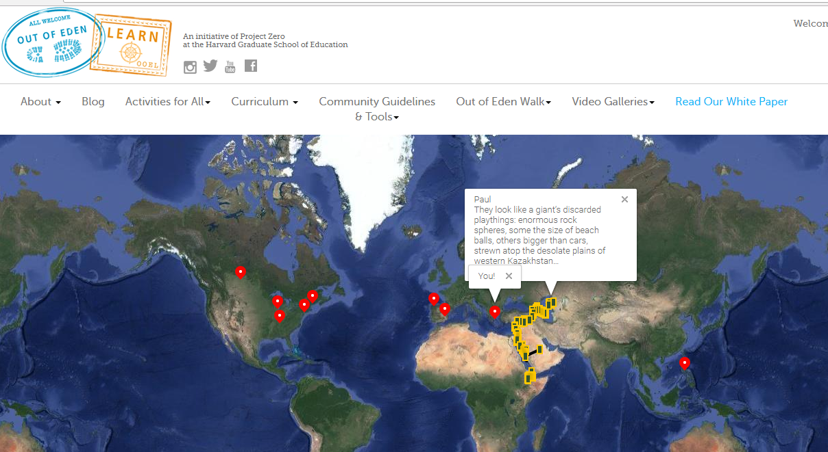
International activities

Slide 27
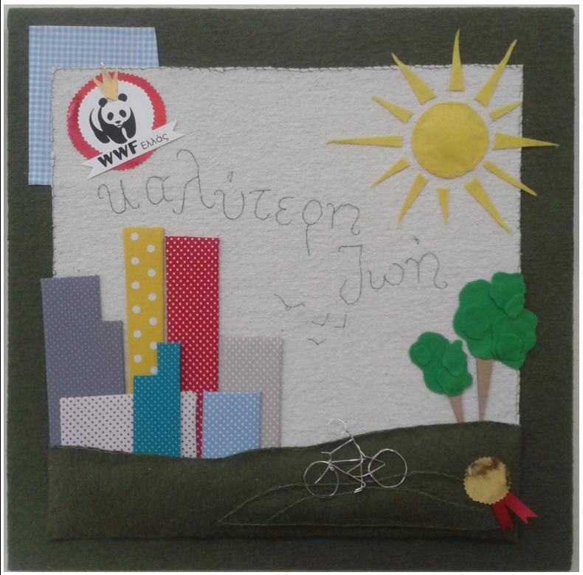
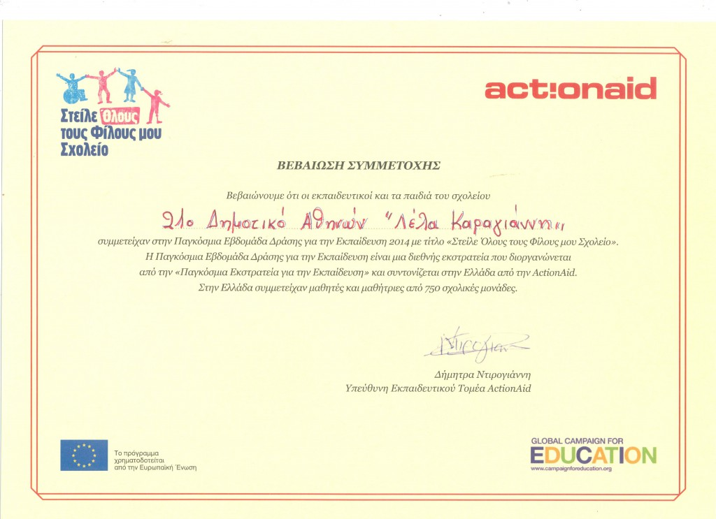
Collaboration with WWF,Actionaid,UNISEF,UNESCO

Slide 28
You are always welcome in 21st Primary School of Athens.
Thank you

